Slide 1
MVP
MerchantSaheb provides Freelance consultants to Startups/ SMBs & individuals in a resource efficient environment with a highly professional Voice.
Note: let ‘MerchantSaheb’ is our initial MVP name, for better explanation let’s call ‘Service provider’ – ‘Merchant’ & ‘Service reciever‘ – ‘Saheb ‘

Slide 2
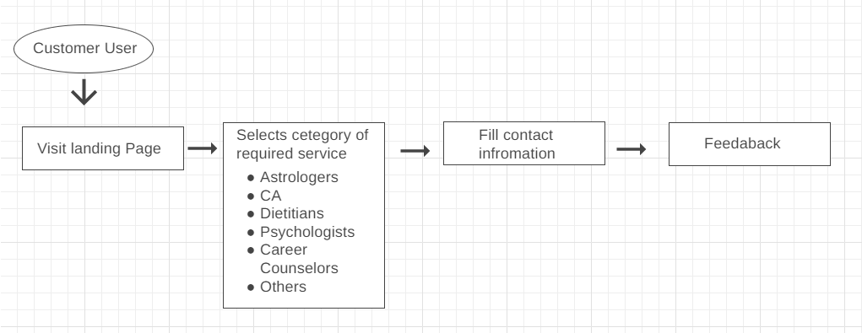
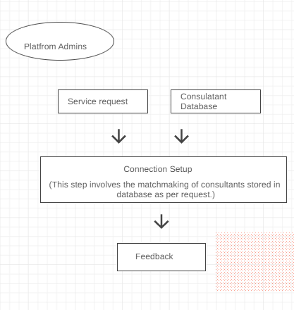
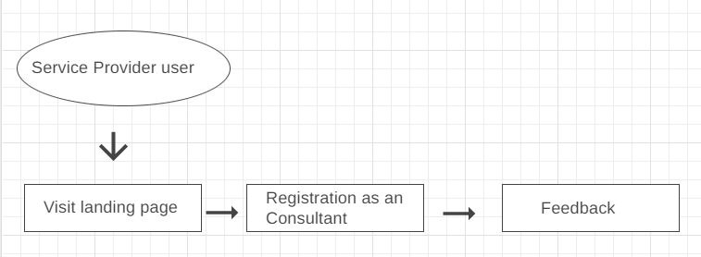
User Flow

Slide 3
Resource Required
As an MVP a product should be launched as soon as possible with the minimal features so it will be the best idea to have a working channel of interaction. We can create a Webapp in less time. For this we’ll need only
Web hosting & domain (₹3000/- approx.)
Any cloud Spreadsheet (Free of cost)
Required time to design a landing page : 2 -3 days with proper content research

Slide 4
MVP Validation
Must have
Would have
Automation
User dashboards
Mobile Applications
Landing page
Interesting UI
Impact
CRM
Effort

Slide 5
User Story
Service receiver 1. As an Service receiver user I should be able to search consultants according to my requirement
2. As an Service receiver user I should be able to book an Query
3. As an Service receiver user I should be getting response from website’s admin
Service Provider 1. As an Service provider user (consultant) I should be able to register myself as a service provider
2. As an Service provider user (consultant) I should be contacted or informed whenever my service request receive

Slide 6
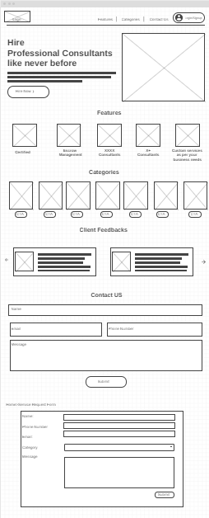
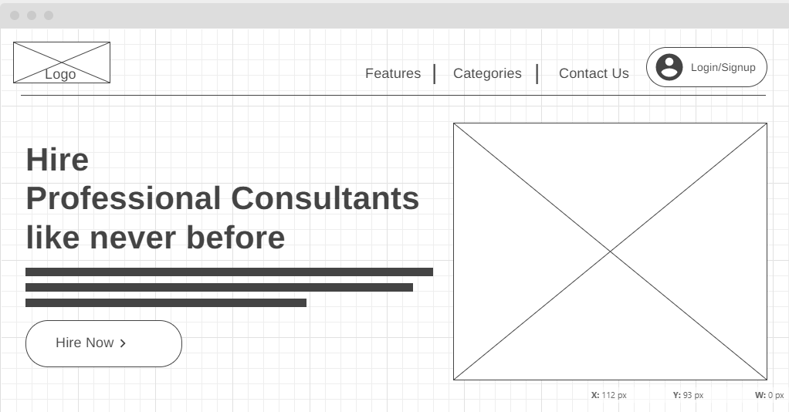
Wireframes

Slide 7
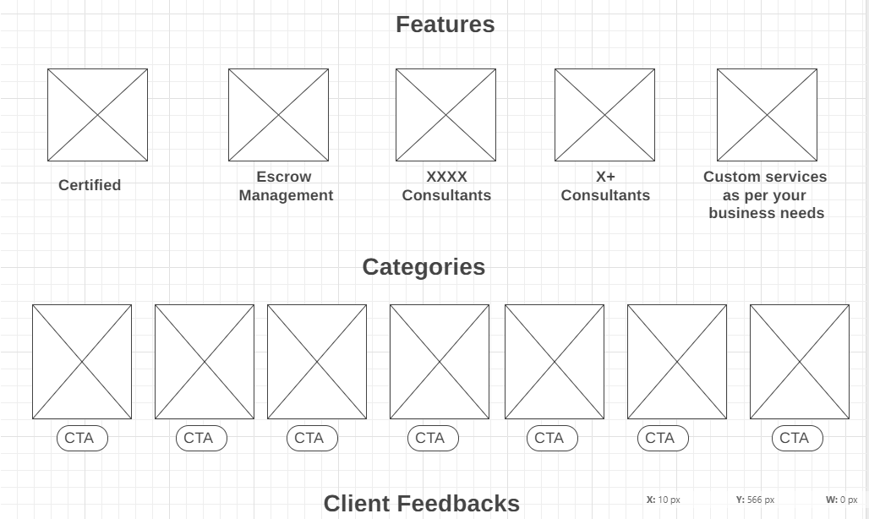

Slide 8
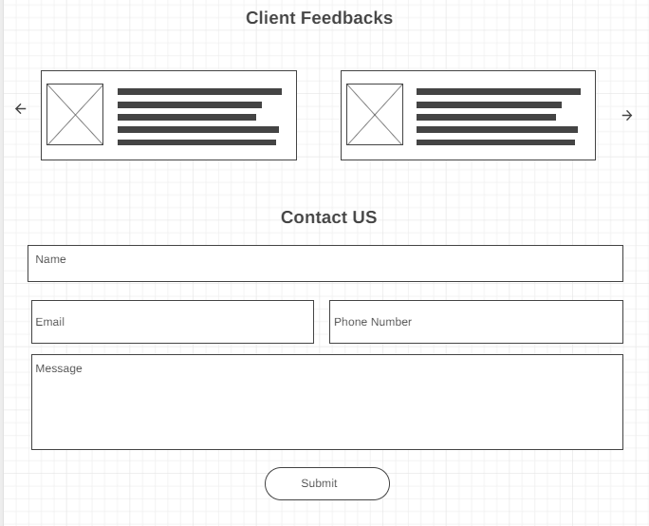
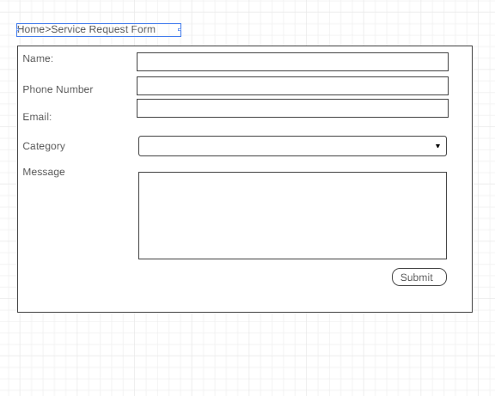

Slide 9
1st Month Launch
3rd Month Hit first 10000 Registrations
6th Month Covert 10% Subscribers as paid customers
6th-12th Month Pilot run of Freemium model 1
Milestones

Slide 10
Revenue
From Service Receivers :
1. Freemium model initially(validation stage- no commission )
2. Subscription offering priority service, higher experience profile, fast hiring (after Successful validation)
From Service Providers (Consultants):
1. Freemium model initially(validation stage- no commission )
2. 20% commission after getting 2 project (06-12 months)
3. 20% commission Straight (after 12 months )

Slide 11
Future Scope
1.Mobile Application 2. After having enough data we’ll have access to our most selling categories and we can maintain a self inventory kind thing which will increase in revenue and service availability
3. A career website
4. A community of consultants

